Slide 1
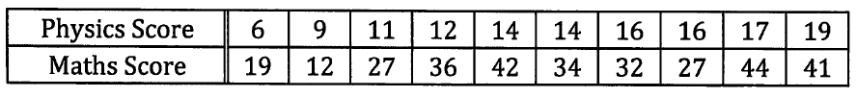
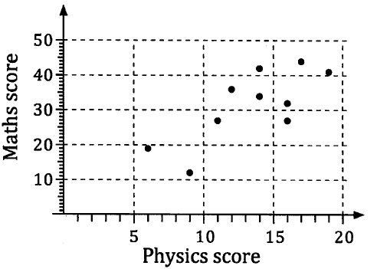
Unit 3 Chapter 2A
Ten students took both a physics test and a mathematics test; their scores were shown in a table and a scatterplot drawn. The oval going from lower left to upper right indicates that for students who did well in the physics test also tended to do well in the mathematics test and vice versa.
We say that the scatter graph shows positive correlation between the physics scores and the maths scores.
If positive correlation exists between two variables, as one increase the other increases and our ‘line of best fit’ will have a positive gradient.
If the points had formed an oval from upper left to lower right, that would have suggested negative correlation, where one variables increases as the other decreases (the ‘line of best fit’ would have a negative gradient).

Slide 2
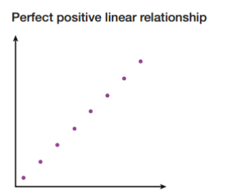
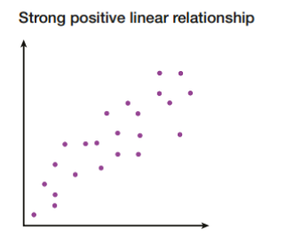
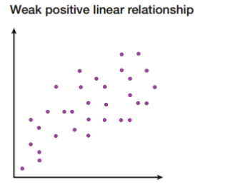
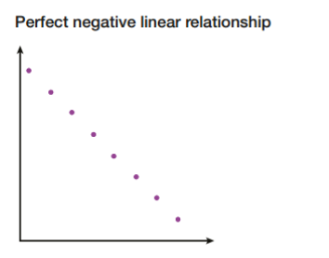
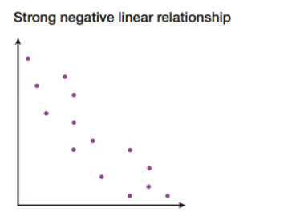
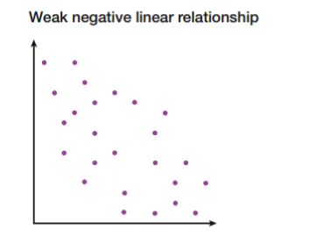
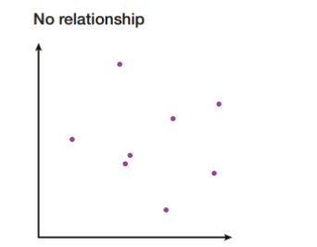
Unit 3 Chapter 2A

Slide 3
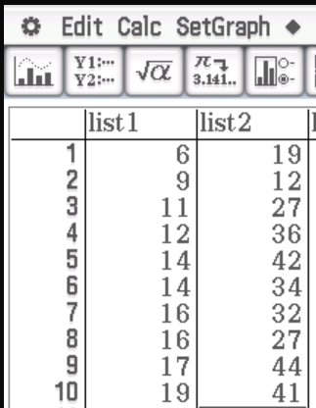
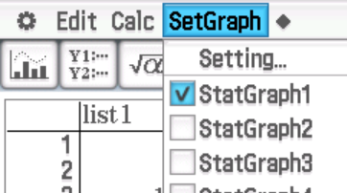
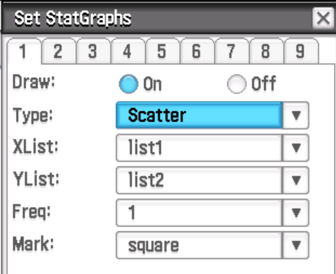

Unit 3 Chapter 2A
So far we have drawn lines of best fit by ‘eye-balling’ the scatter plot and drawing the straight line that seemed to best fit the data. This is not the strongest method as what one person considers the best line may be different to another.
We can use a calculator to determine the line considered to be the best straight line, give its equation and use it to predict values.
Looking at the maths and physics test results again, we would enter these values into a Class Pad first.

Slide 4
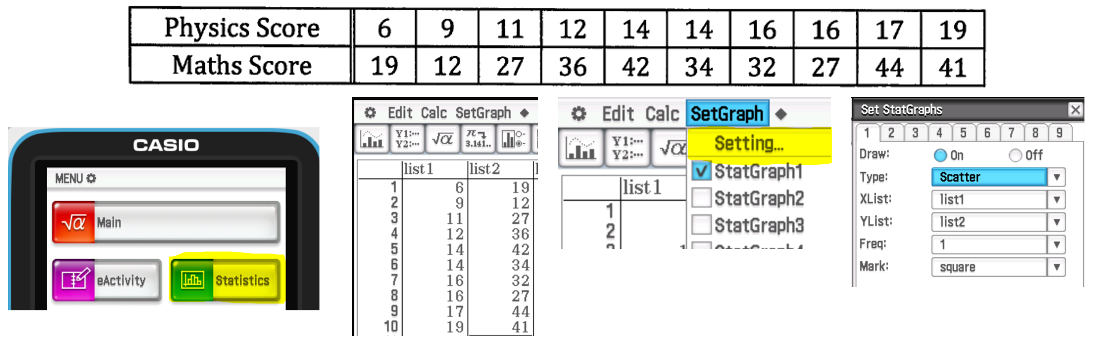

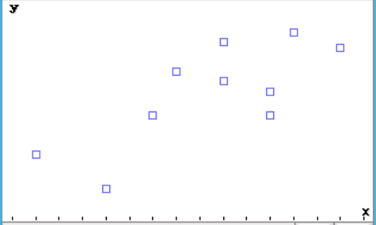
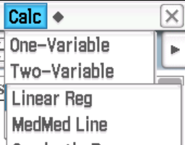
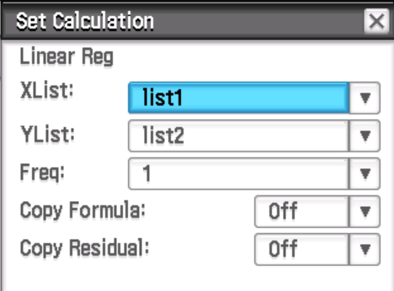
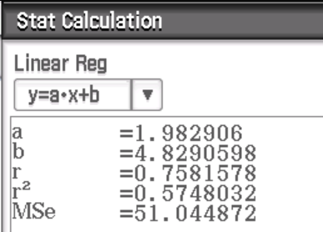
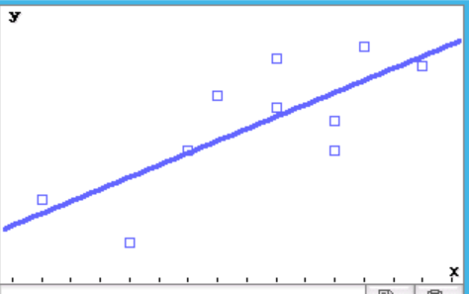
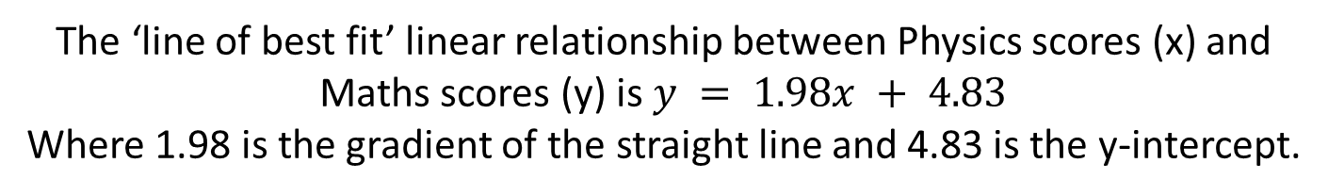
Unit 3 Chapter 2A
The ‘line of best fit’ linear relationship between Physics scores (x) and Maths scores (y) is $y = 1.98x + 4.83$
Where 1.98 is the gradient of the straight line and 4.83 is the y-intercept.

Slide 5
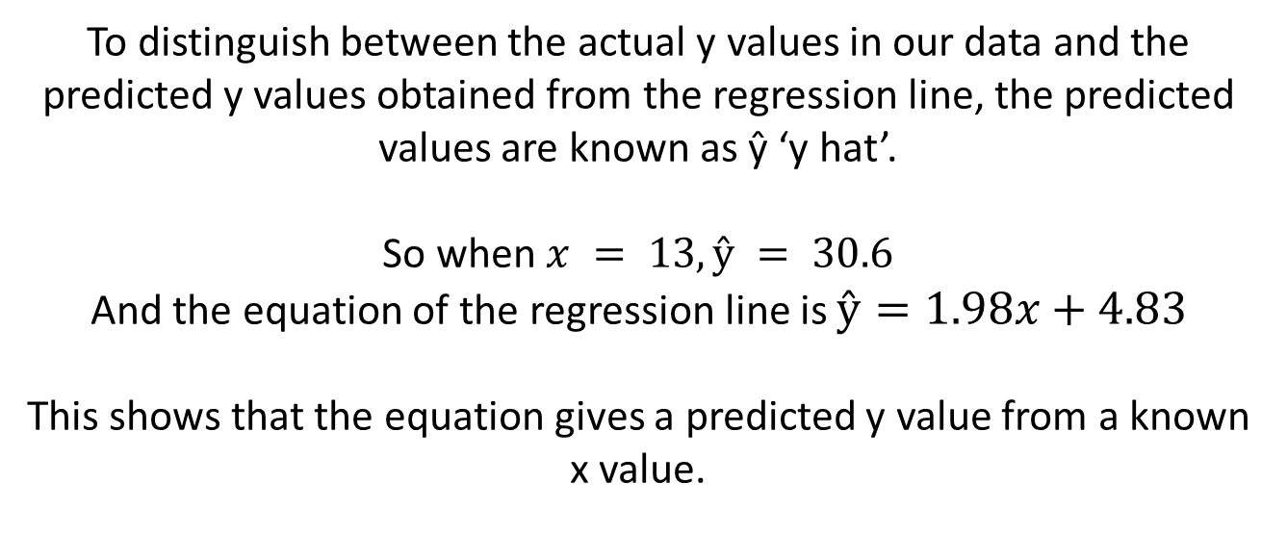
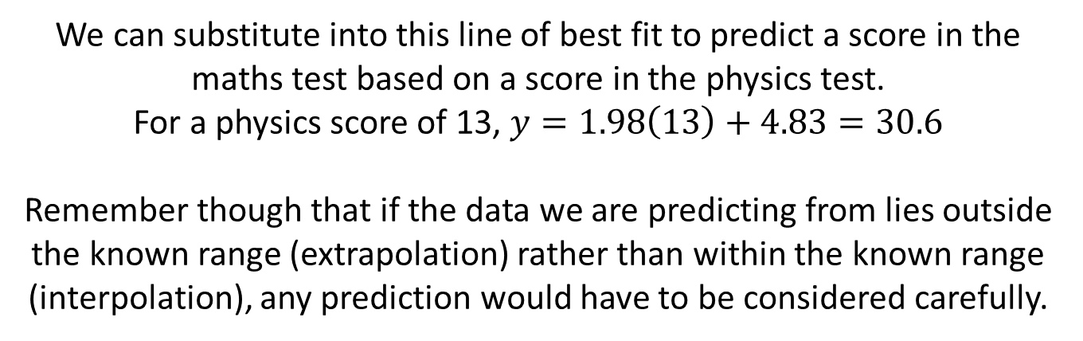
Unit 3 Chapter 2A
Now try Chapter 2A
$$y = 1.98x + 4.83$$
We can substitute into this line of best fit to predict a score in the maths test based on a score in the physics test.
For a physics score of 13, $y=1.98\left(13\right)+4.83=30.6$
Remember though that if the data we are predicting from lies outside the known range (extrapolation) rather than within the known range (interpolation), any prediction would have to be considered carefully.
To distinguish between the actual y values in our data and the predicted y values obtained from the regression line, the predicted values are known as ŷ ‘y hat’.
So when $x = 13, ŷ = 30.6$
And the equation of the regression line is $ŷ=1.98x+4.83$
This shows that the equation gives a predicted y value from a known x value.

